Slide 1
Capstone Engagement
Assessment, Analysis, and Hardening of a Vulnerable System
By
Kabiru Sanusi

Slide 2
Table of Contents
This document contains the following sections:
01
Network Topology
02
Red Team: Security Assessment
03
Blue Team: Log Analysis and Attack Characterization
Hardening: Proposed Alarms and Mitigation Strategies
04

Slide 3
Network Topology
‹#›

Slide 4
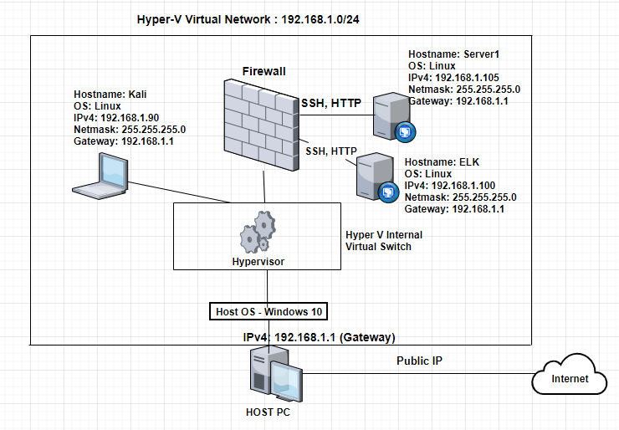
Network Topology
[Insert Here]
Use draw.io to create a diagram of the network.
Add your diagram to this slide and fill out the data in the sidebar.
Network
Address Range: 192.168.1.1 - 192.168.1.254
Netmask: 255.255.255.0
Gateway: 192.168.1.1
Machines
IPv4: 192.168.1.1
OS: Microsoft Windows 10 Pro
Hostname: ML-RefVm-684427
IPv4: 192.168.1.90
OS: Linux
Hostname: Kali
IPv4: 192.168.1.100
OS: Linux
Hostname: ELK
IPv4: 192.168.1.105
OS: Linux
Hostname: Server1

Slide 5
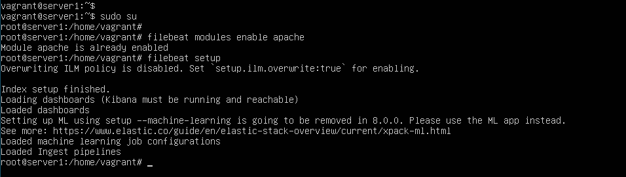
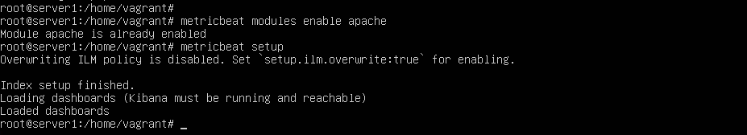
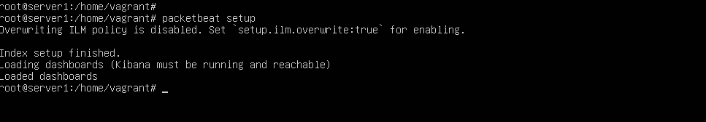
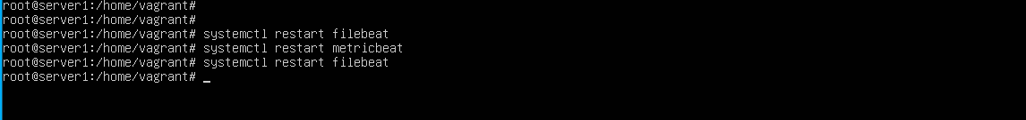

Slide 6

Red Team
Security Assessment
‹#›

Slide 7
Recon: Describing the Target
Nmap identified the following hosts on the network:
Hostname | IP Address | Role on Network
Server1 | 192.168.1.105 | Victim Machine (Target)
Kali | 192.168.1.90 | Attacking Machine
ML-REFVM-684427 | 192.168.1.1 | Gateway Router
ELK | 192.168.1.100 | ELK Server.

Slide 8
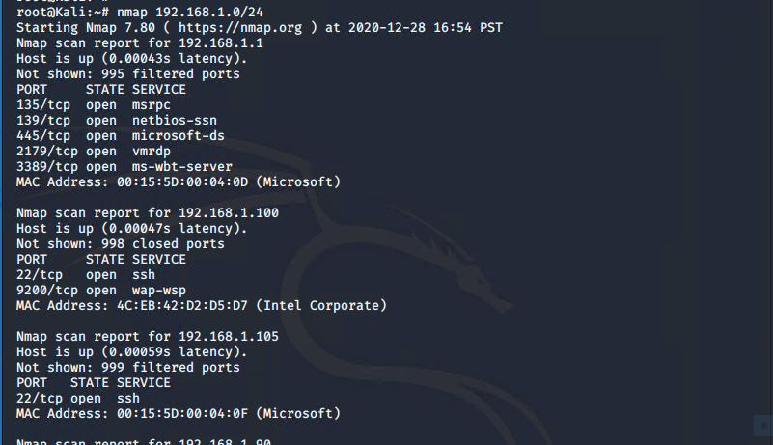
Nmap command

Slide 9
Vulnerability Assessment
The assessment uncovered the following critical vulnerabilities in the target:
Vulnerability | Description | Impact
Use the CVE number if it exists. Otherwise, use the common name. | Describe the vulnerability. | Describe what this vulnerability allows the attacker to do.
CVE-2019-0211 OR Remote Code Execution | In Apache HTTP Server 2.4 releases 2.4.17 to 2.4.38, with MPM event, worker or prefork, code executing in less-privileged child processes or thread (including in-process interpreter) could execute arbitrary code with the privileges of the root process. Non-Unix systems are not affected. | Apache HTTP Server Privilege Escalation Vulnerability allows attackers to run a malware to gain access into the victim’s system and escalate to root privilege for total control of the system by using command-and-control (C2) server.
CVE-2018-15919 | Allows remotely observable behaviour in an auth-gss2.c., known as user enumeration in OpenSSH through version 7.8 | An Attacker can bypass access restrictions to data through Username Enumeration of OpenSSH to obtain sensitive information

Slide 10
Vulnerability Assessment
The assessment uncovered the following critical vulnerabilities in the target:
Vulnerability | Description | Impact
Use the CVE number if it exists. Otherwise, use the common name. | Describe the vulnerability. | Describe what this vulnerability allows the attacker to do.
CVE-2018-1312 | In Apache httpd 2.2.0 to 2.4.29, the HTTP Digest authentication challenge used to prevent replay was not correctly generated. | An attacker can replay an HTTP requests without detection
Brute force vulnerability | Weak passwords are easily to crack within few seconds using various open source tools. | An attacker can use the cracked user password to gain access to user account and access access sensitive information.
Unauthorized file Upload | This is mostly the first step in many attacks. Majorly by getting malicious code into the victim’s box. | The impact could help the attacker to completely takeover the victim’s system. Overloaded the database, or deface the website depending on what the uploaded file does.

Slide 11
Vulnerability Assessment
The assessment uncovered the following critical vulnerabilities in the target:
Vulnerability | Description | Impact
Use the CVE number if it exists. Otherwise, use the common name. | Describe the vulnerability. | Describe what this vulnerability allows the attacker to do.
Sensitive Data Exposure | This is caused by inadequate protection of sensitive data by application using weak crypto. | This could allow attacker to read the data.

Slide 12
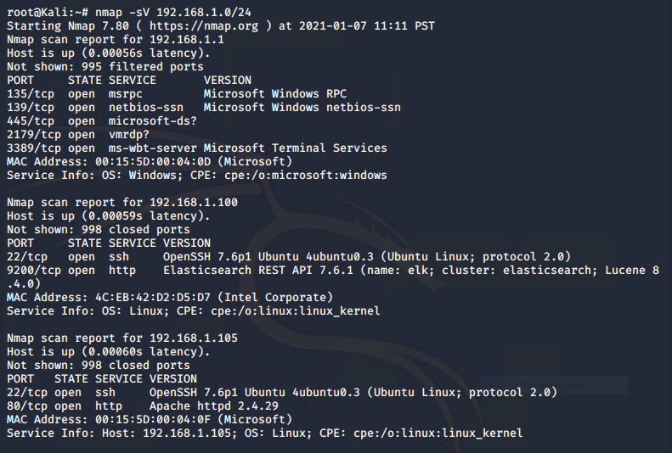
Reconnaissance & Enumeration
Open Ports / OS

Slide 13
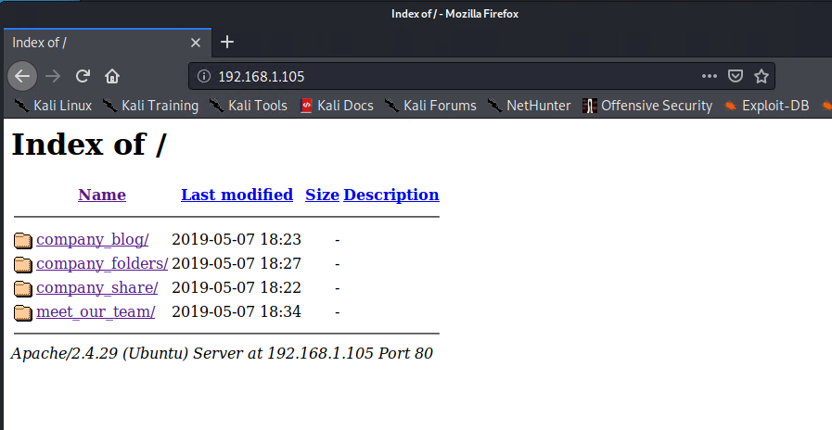
Reconnaissance & Enumeration
Web discovery
We access a static website under construction:
Directories/ files discovery show some basic information.

Slide 14
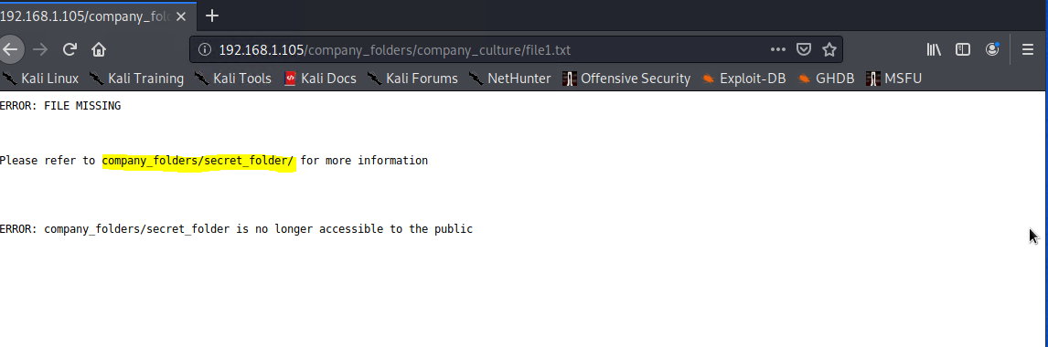
Reconnaissance & Enumeration
Web discovery
We access a static website under construction:
Directories/ files discovery show some basic information.

Slide 15
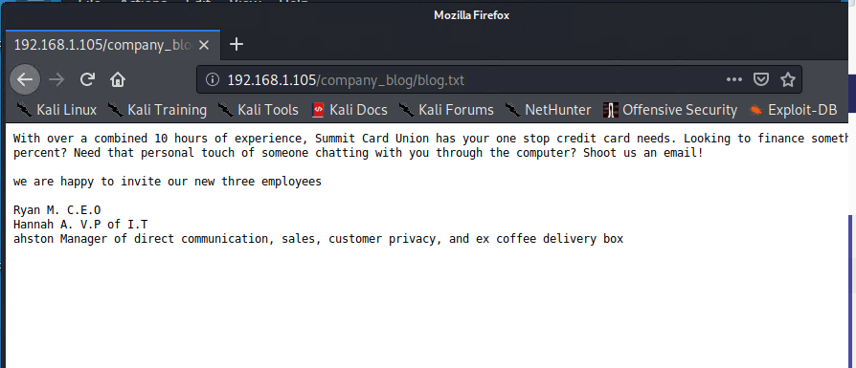
Reconnaissance & Enumeration
Web discovery
We access a static website under construction:
Directories/ files discovery show some basic information.

Slide 16
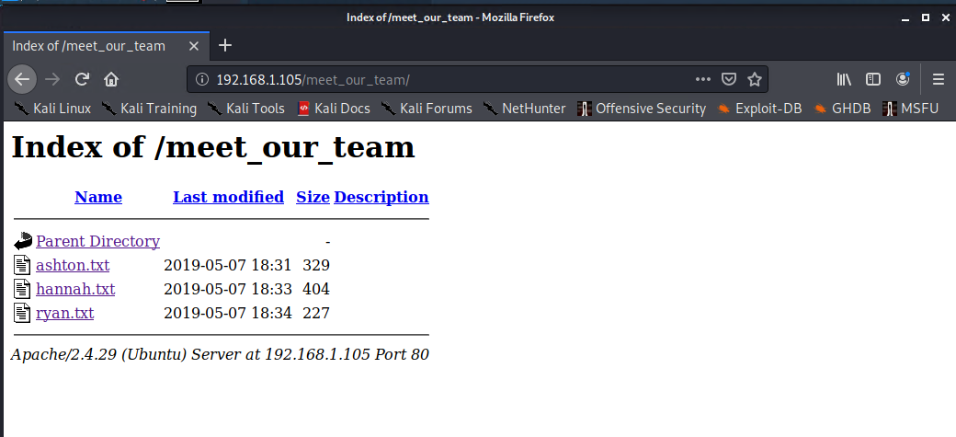
Reconnaissance & Enumeration
Web discovery
We access a static website under construction:
Directories/ files discovery show some basic information.

Slide 17
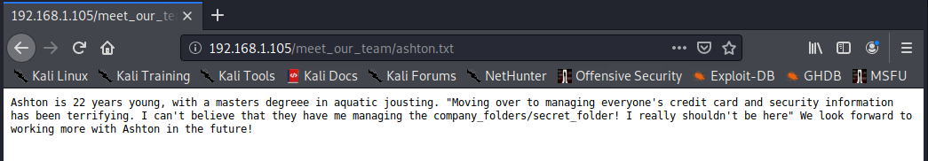
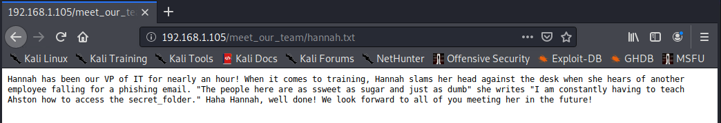
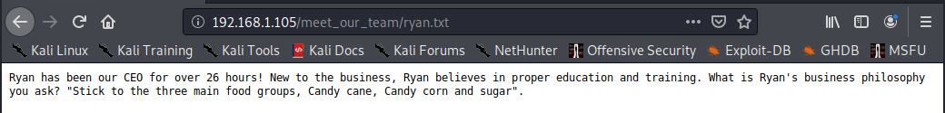
Reconnaissance & Enumeration
Web discovery
Directories/ files discovery show some basic information.

Slide 18
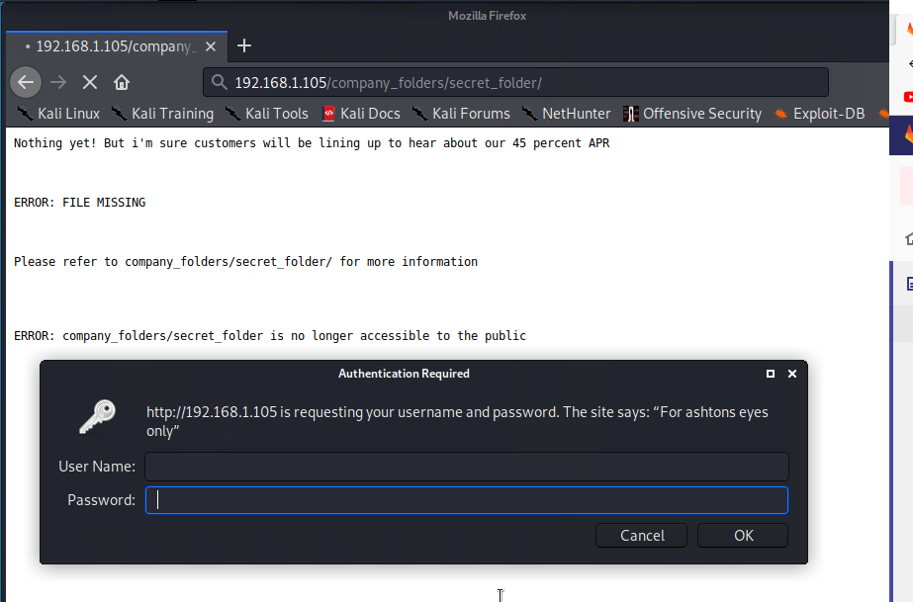
Reconnaissance & Enumeration
Web discovery

Slide 19
Exploitation: [Password Vulnerability]
01
02
03
Tools & Processes
How did you exploit the vulnerability? Which tool (Nmap, etc.) or techniques (XSS, etc.) did you use?
ANSWER:
Tools used: hydra,
CrackStation
Achievements
What did the exploit achieve? For example: Did it grant you a user shell, root access, etc.?
ANSWER:
Bruteforce password for the hidden directory -
/Company_folder/Secret_folder. Using the cracked password to log on with ashton credential.
[INSERT: screenshot or command output illustrating the exploit.]
ANSWER:
Screenshots below.

Slide 20
Brute forcing password

Slide 21
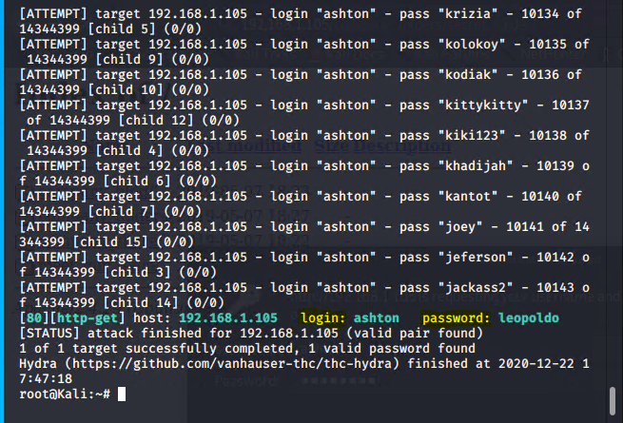
Brute forcing password using hydra

Slide 22
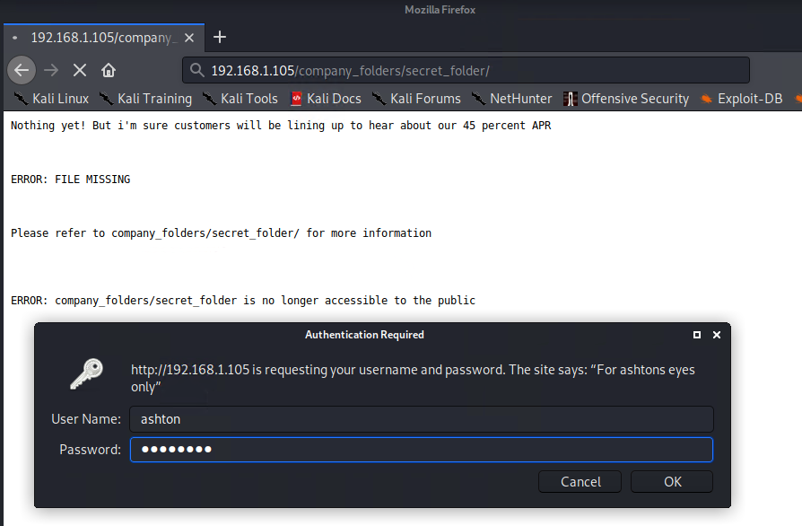
Logon credential > ashton:leopoldo

Slide 23
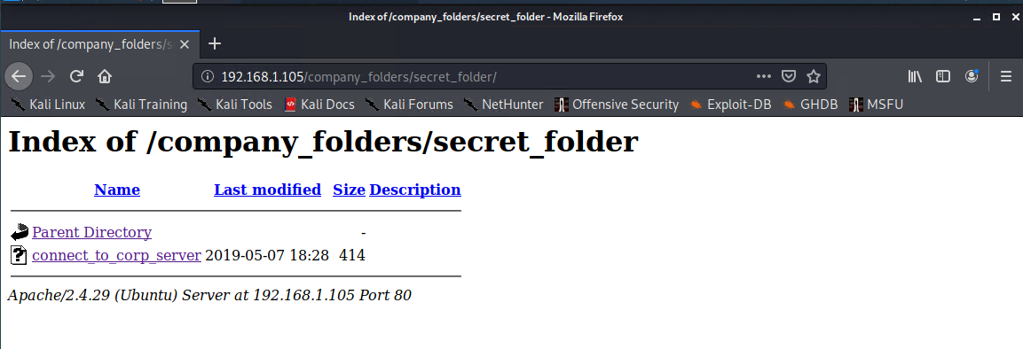
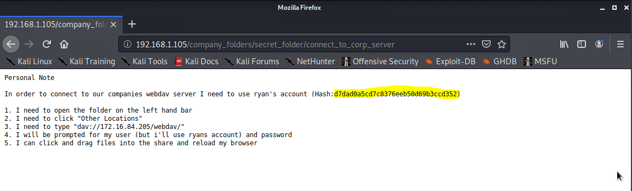
Access to the Secret folder
Accessing the connect_to_corp_server file revealed sensitive information stored by ashton and a hash.

Slide 24
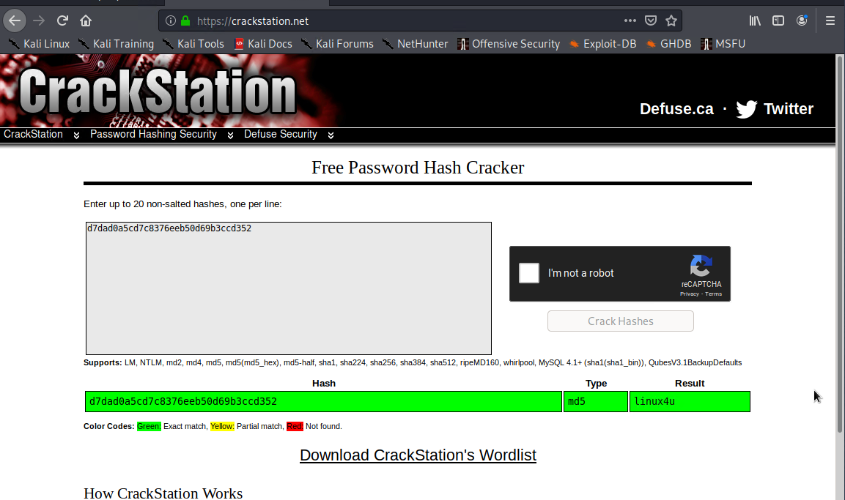
Break the hash password using CrackStation
linux4u

Slide 25
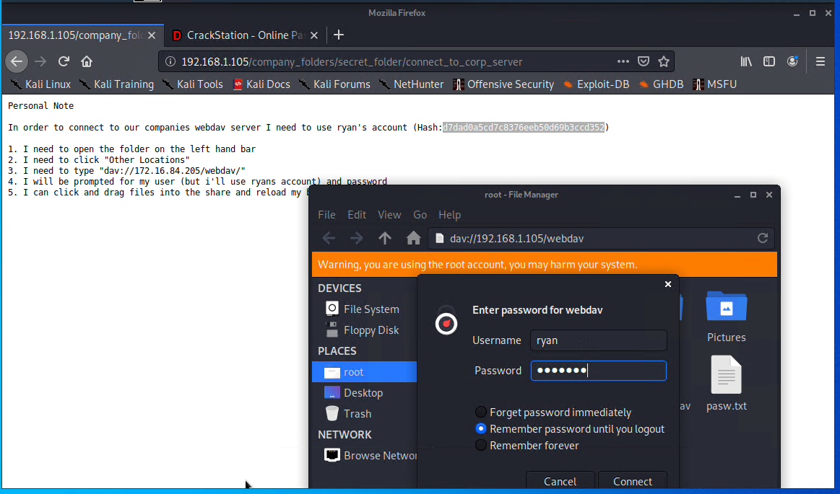
Connect to server1 through Webdav
Credential > ryan:linux4u

Slide 26
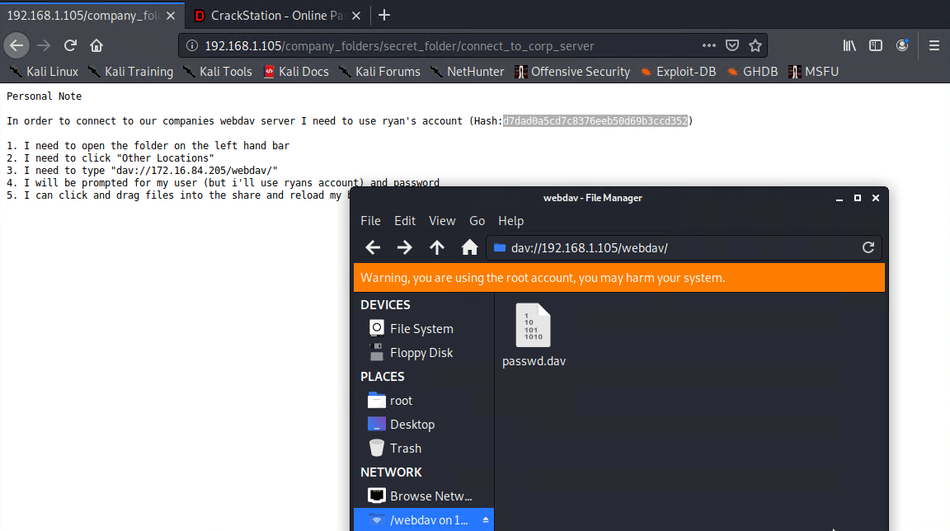
Gained access to the server.

Slide 27
Exploitation: [Backdoor Vulnerability]
01
02
03
Tools & Processes
How did you exploit the vulnerability? Which tool (Nmap, etc.) or techniques (XSS, etc.) did you use?
ANSWER:
MSFVenom, PHP Payload, scp, Meterpreter
Achievements
What did the exploit achieve? For example: Did it grant you a user shell, root access, etc.?
ANSWER:
Generated a PHP payload, and uploaded to the target server (Server1).
[INSERT: screenshot or command output illustrating the exploit.]
ANSWER:
Screenshots below explained the processes.

Slide 28
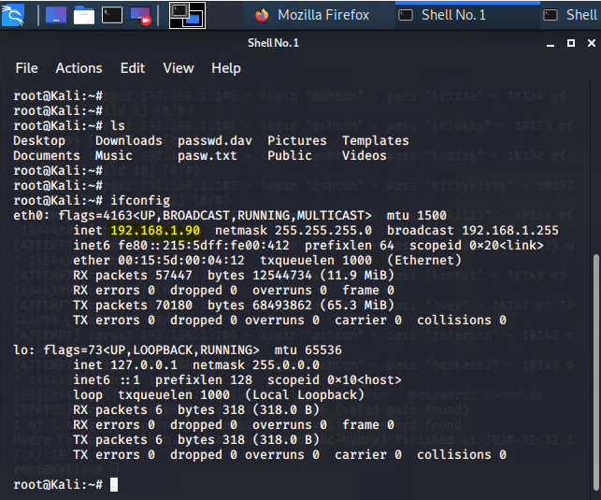
Determine the IP Address of the Attacking Machine (Kali)
192.168.1.90

Slide 29
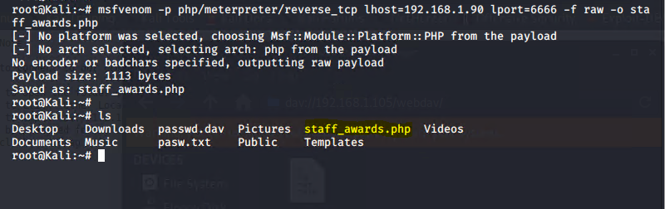
Generated PHP payload and Uploaded
PHP Payload:
staff_awards.php generated.
Note:
The php file could be named to coerce user to clicked on on the web page.

Slide 30
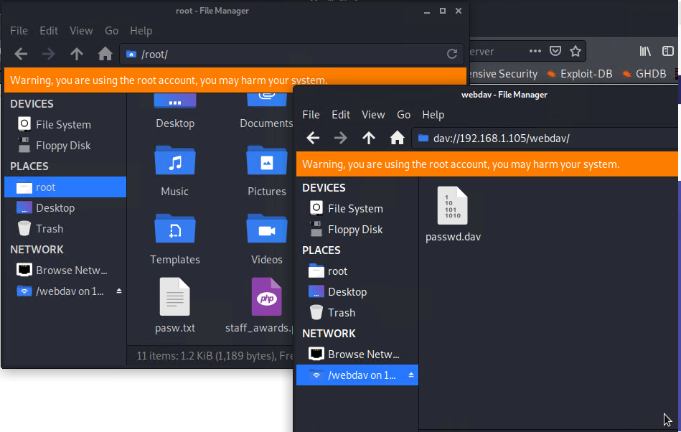
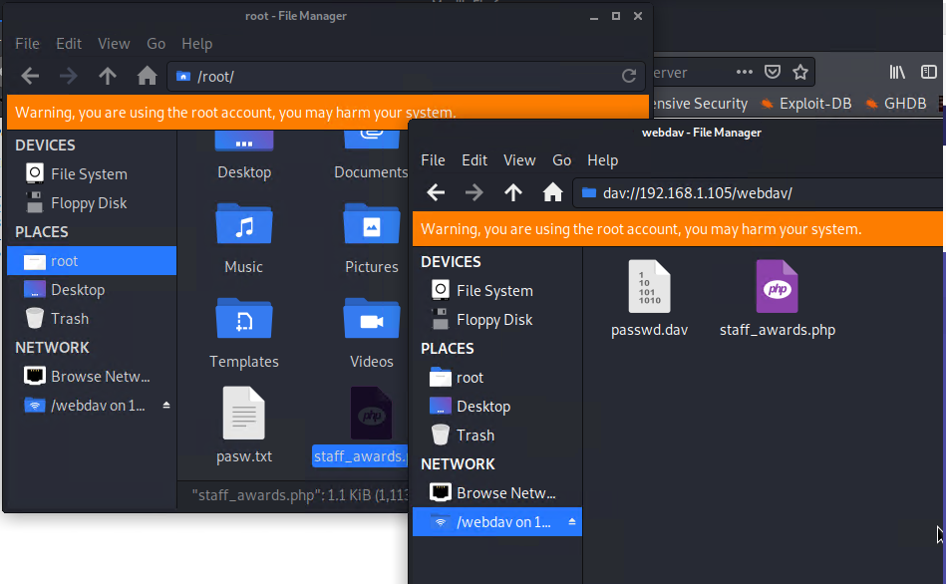
Moving staff_awards.php payload to a share directory
staff_awards.php

Slide 31
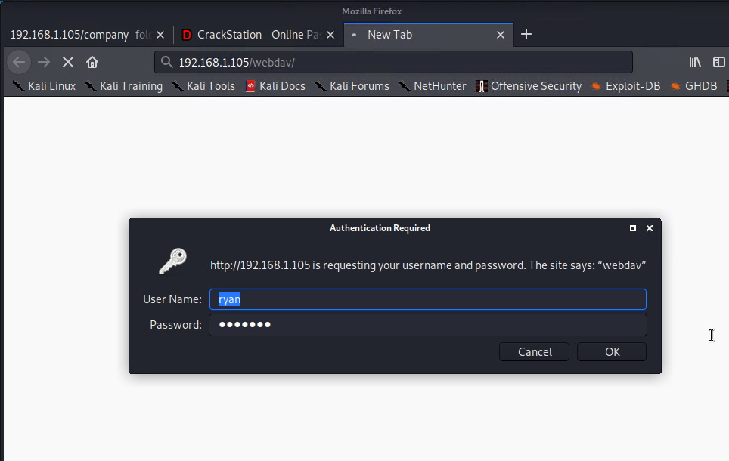
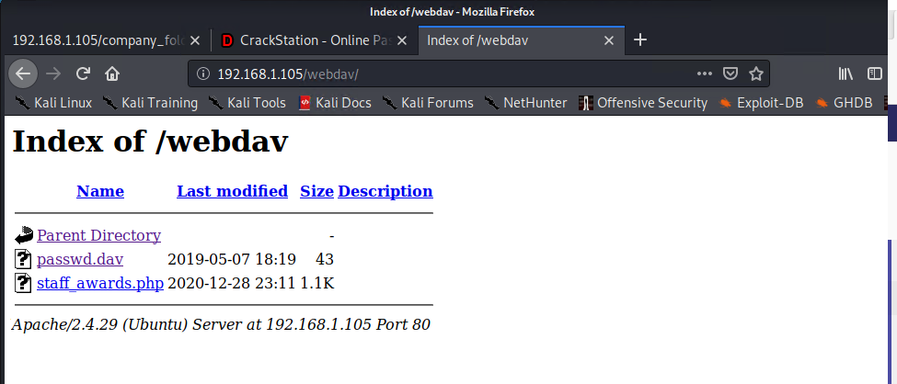
Navigate to http://192.168.1.105/webdav
Log on with ryan:linux4u credential

Slide 32
Exploitation: [Privilege Escalation Vulnerability]
01
02
03
Tools & Processes
How did you exploit the vulnerability? Which tool (Nmap, etc.) or techniques (XSS, etc.) did you use?
ANSWER:
Meterpreter, multi/handler, and shell
Achievements
What did the exploit achieve? For example: Did it grant you a user shell, root access, etc.?
ANSWER:
Provided interactive shell to explore the target machine (Server1) and execute code.
[INSERT: screenshot or command output illustrating the exploit.]
ANSWER:
Screenshots of process shown below;

Slide 33
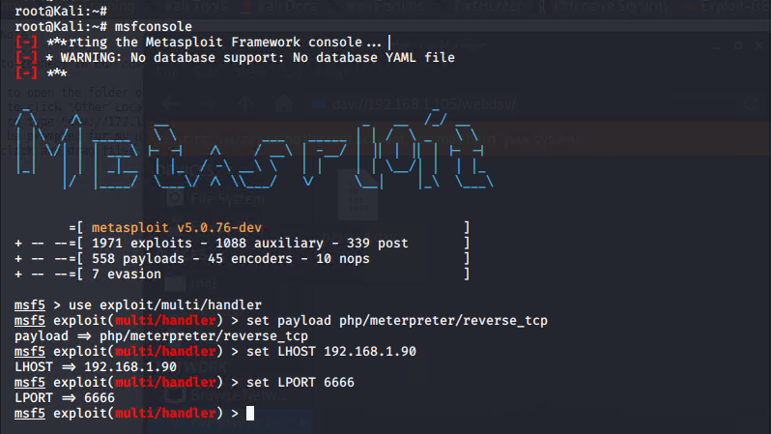
Start Metasploit on Kali machine
Use the command - msfconsole

Slide 34
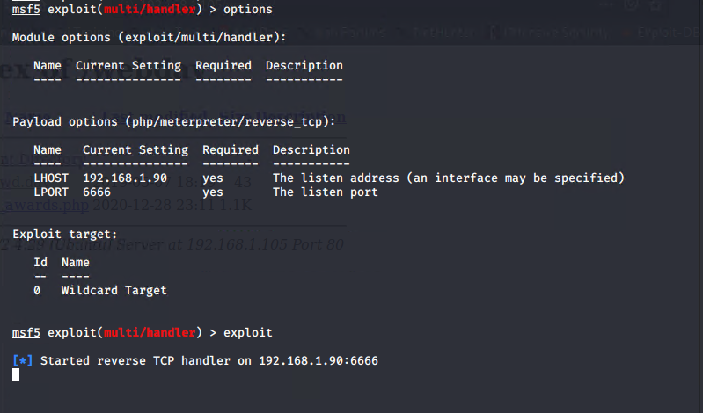
Use exploit/multi/handler

Slide 35
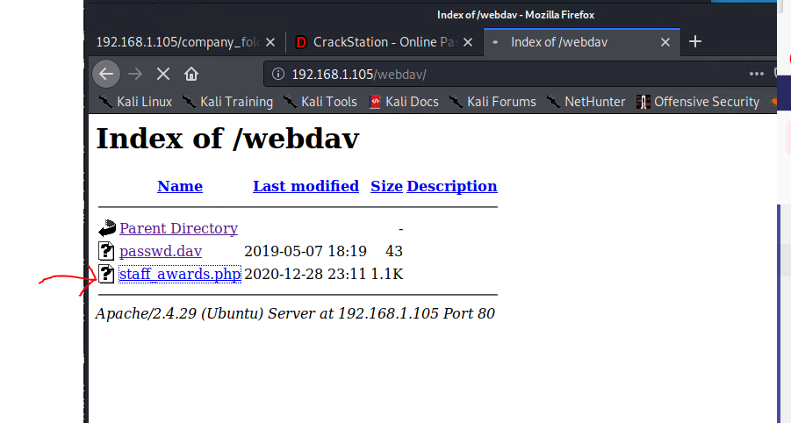
Click the staff_awards.php file
Create the listening for the reverse shell

Slide 36
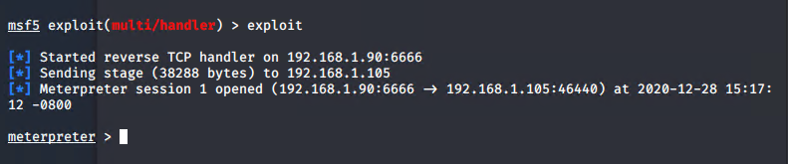
Run the exploit - i.e the php payload

Slide 37
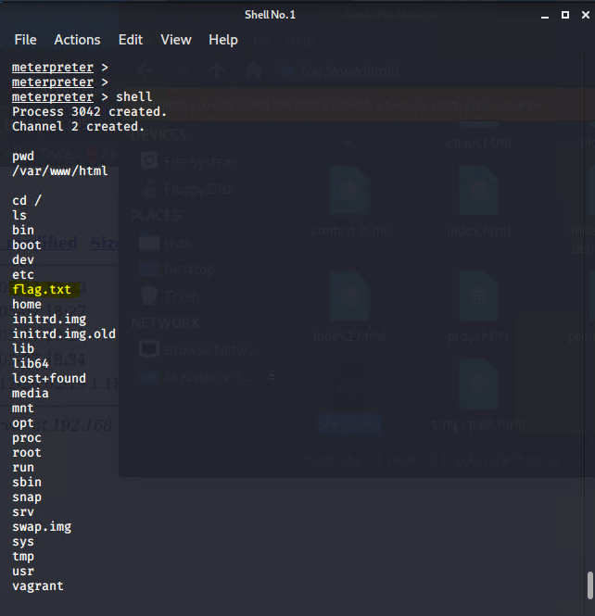
Run the shell command:

Slide 38
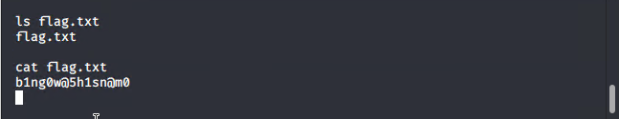
Escalate Privilege
Find the flag.txt file.

Slide 39

Blue Team
Log Analysis and Attack Characterization
‹#›

Slide 40

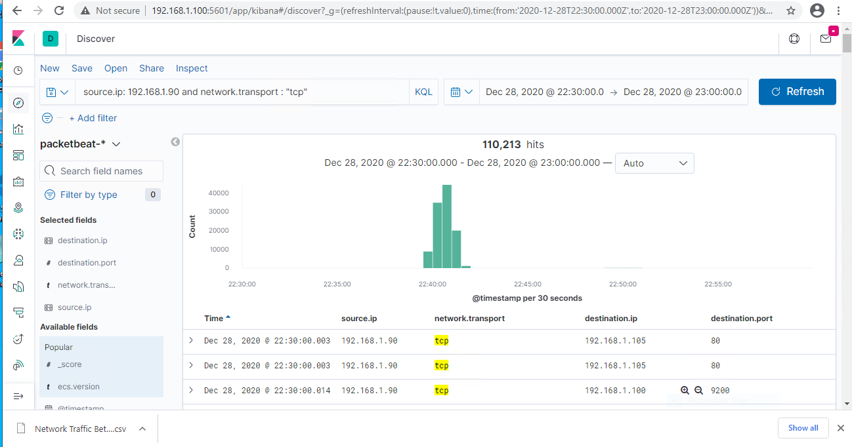
Analysis: Identifying the Port Scan
Answer the following questions in bullet points under the screenshot if space allows. Otherwise, add the answers to speaker notes.
What time did the port scan occur?
How many packets were sent, and from which IP?
What indicates that this was a port scan?
[Insert Here]
Include a screenshot of Kibana logs depicting the port scan.
Notes:
Time of port scan : Dec 28, 2020 @ 22:30:00.003
Count of Packets sent: 110,213
Source IP : 192.168.1.90
What indicated Port Scan: About 44,520 tcp packets were sent within 30 seconds. (ie. @ 22:40:30.000 - 22:41:00.000)

Slide 41
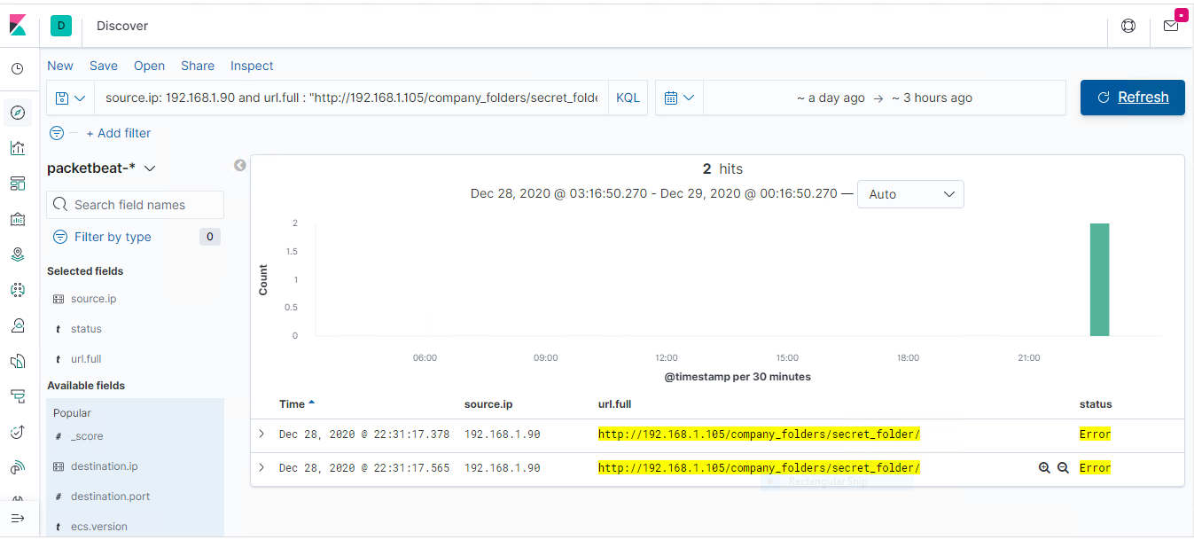
Analysis: Finding the Request for the Hidden Directory
Answer the following questions in bullet points under the screenshot if space allows. Otherwise, add the answers to speaker notes.
What time did the request occur? How many requests were made?
Which files were requested? What did they contain?
[Insert Here]
Include a screenshot of Kibana logs depicting the request for the hidden directory.
Notes:
Time of the requested Hidden Directory: Dec 28, 2020 @22:31:17.378
Request Numbers: 2
File requested was connect_to_corp_server. It contains the login information to the webdav server.

Slide 42
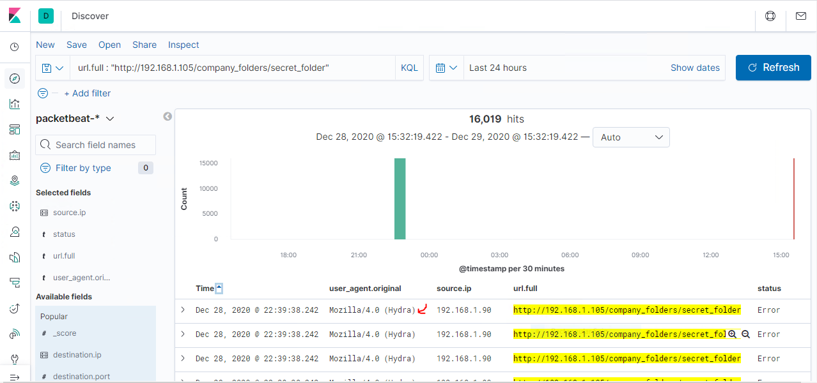
Analysis: Uncovering the Brute Force Attack
Answer the following questions in bullet points under the screenshot if space allows. Otherwise, add the answers to speaker notes.
How many requests were made in the attack?
How many requests had been made before the attacker discovered the password?
[Insert Here]
Include a screenshot of Kibana logs depicting the brute force attack.
Notes:
Total requests made in the attack : 16,019
Numbers of request made before the password was discovered: 16,017

Slide 43
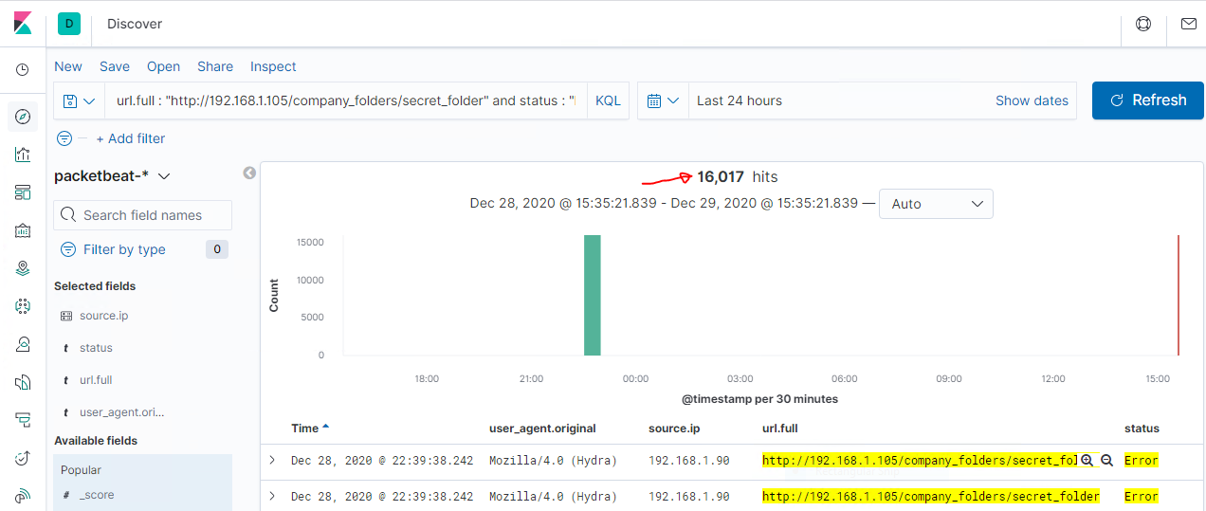
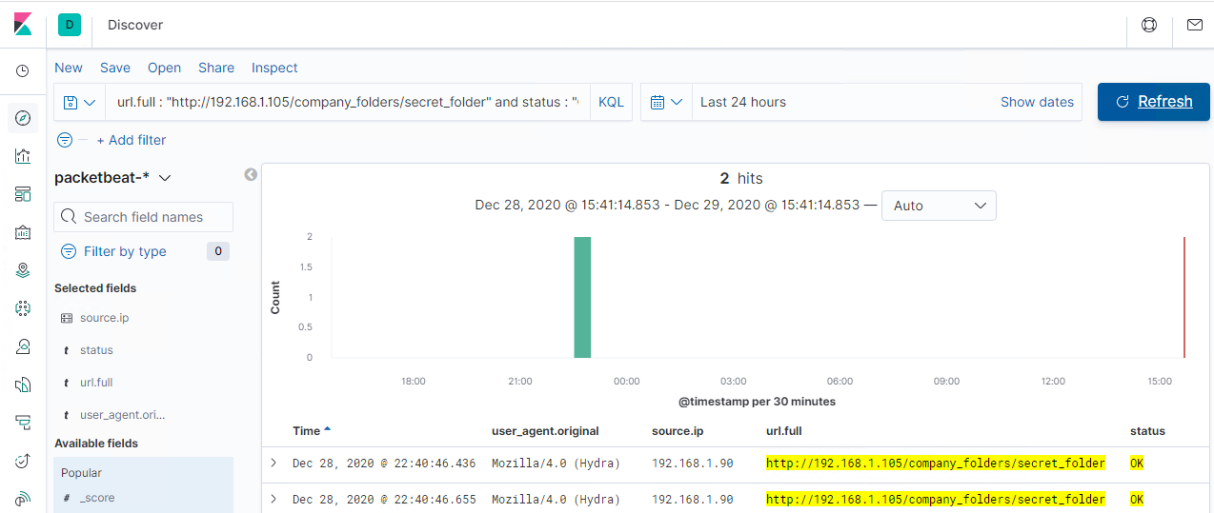
Error
Hydra packet status
OK

Slide 44
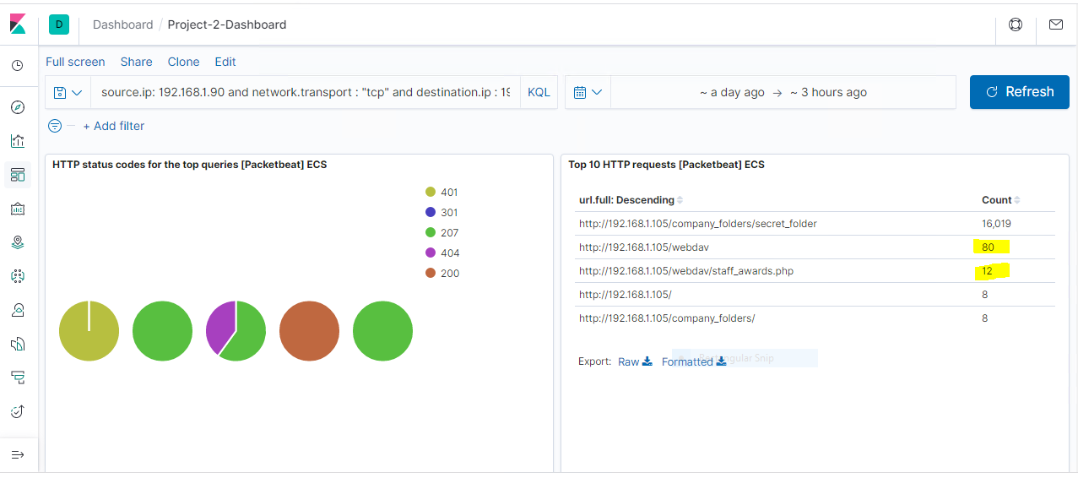
Analysis: Finding the WebDAV Connection
Answer the following questions in bullet points under the screenshot if space allows. Otherwise, add the answers to speaker notes.
How many requests were made to this directory?
Which files were requested?
[Insert Here]
Add a screenshot of Kibana logs depicting the WebDAV connection.
Notes:
Total Requests made to /webdav directory : 80
Requested file: staff_awards.php

Slide 45
Blue Team
Proposed Alarms and Mitigation Strategies
‹#›

Slide 46
Mitigation: Blocking the Port Scan
What kind of alarm can be set to detect future port scans?
Answer: Implement (Snort rule)
Intrusion Detection System
When tcp traffics are received on port not open.
What threshold would you set to activate this alarm?
If tcp traffic received on port not open (e.g. 23 for telnet) on server1 is more than 0.
What configurations can be set on the host to mitigate port scans?
Ans:
Install host-based firewall (used firewalld)
Install IDS/IPS (Snort)
Setup rules on firewall to blacklist the attacker ip address
Write snort rule to detect port scan and block.
Describe the solution. If possible, provide required command lines.
Ans: Solution details shown below

Slide 47
Mitigation: Blocking the Port Scan : Hardening: Install firewall on host
Run the following code to install firewall: (Install firewalld and set the rules to block the attacker IP)
# sudo apt update -y
# sudo apt install firewalld -y
# systemctl enable firewalld
# systemctl start firewalld
# sudo firewall-cmd --list-all-zones
# sudo firewall-cmd --zone=public --change-interface=eth0 --permanent
# sudo firewall-cmd --zone=public --add-port=22/tcp --permanent
# sudo firewall-cmd --zone=public --add-port=80/tcp --permanent
# sudo firewall-cmd --zone=public --add-service=http --permanent
# sudo firewall-cmd --zone=public --add-icmp-block=echo-reply --permanent
# sudo firewall-cmd --zone=public --add-icmp-block=echo-request --permanent
# sudo firewall-cmd --zone=public --add-rich-rule=’rule family=”ipv4” source address=”192.168.1.90” reject’ --permanent

Slide 48
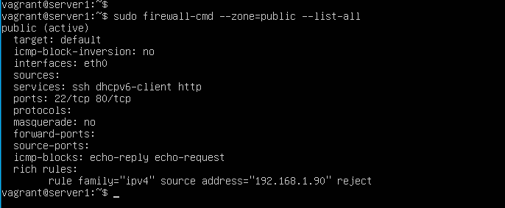
Mitigation: Blocking the Port Scan
Install firewalld on host with rules (contd.)
# sudo firewall-cmd --zone=public --list-all

Slide 49
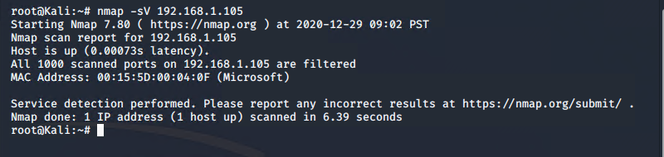
Mitigation: Blocking the Port Scan
Install firewalld on host with rules (contd.) - Testing firewalld rules
Run the nmap command again in Kali machine.
The Kali IP address traffic has been block into the Server1 by the firewall

Slide 50
Mitigation: Blocking the Port Scan
Hardening - Adding another layer of defense
Install IDS (Snort) and set it rules to detect Port Scanning
Use the following commands:
# cd /usr/src
# sudo apt update -y
# sudo apt install snort -y
# snort --version
# sudo vi /etc/snort/rules/local_rules
alert tcp any any -> 192.168.1.105 23 ( msg:”TCP Port Scanning Detected”; sid:1000009; rev:12;)
Turn on IDS mode of snort:
# sudo snort -A console -q -u snort -g snort -c /etc/snort/snort,conf -i etho

Slide 51
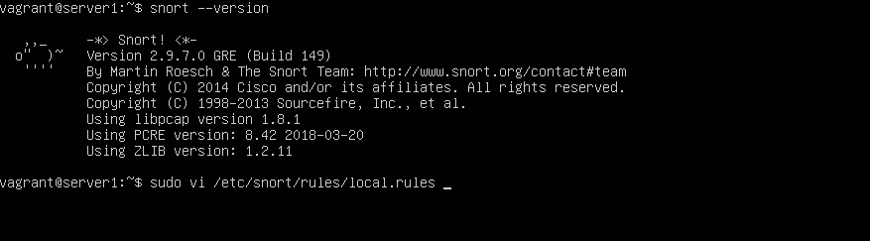
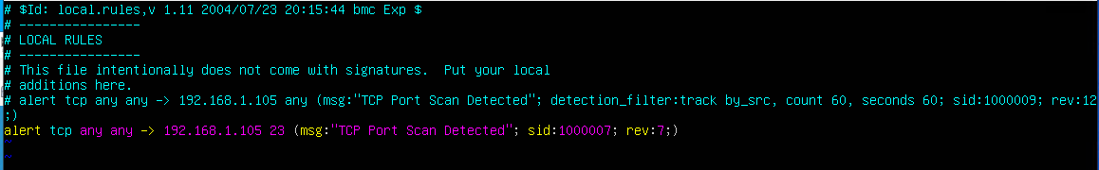
Mitigation: Blocking the Port Scan
Check to confirm snort is installed and write rules.
# sudo firewall-cmd --zone=public --list-all

Slide 52
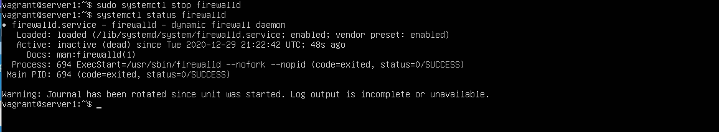
Mitigation: Blocking the Port Scan
Install firewall on host (contd.)
Stop firewalld service to test the snort configuration

Slide 53
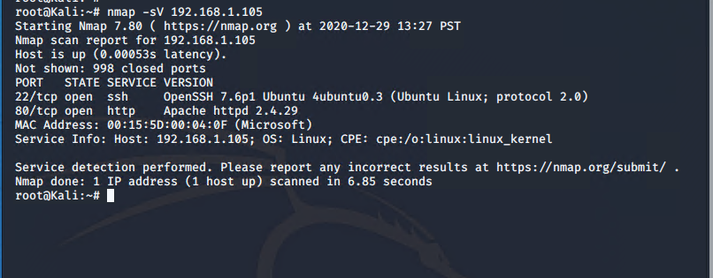
Mitigation: Blocking the Port Scan
Firewall is inactive:

Slide 54
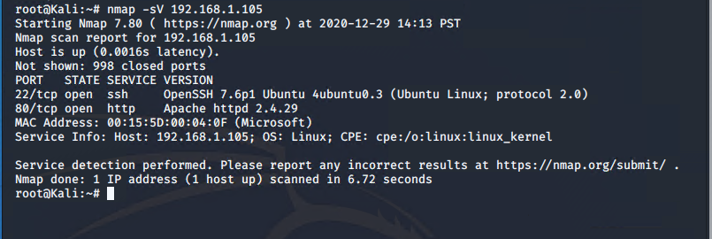
Mitigation: Blocking the Port Scan

Slide 55
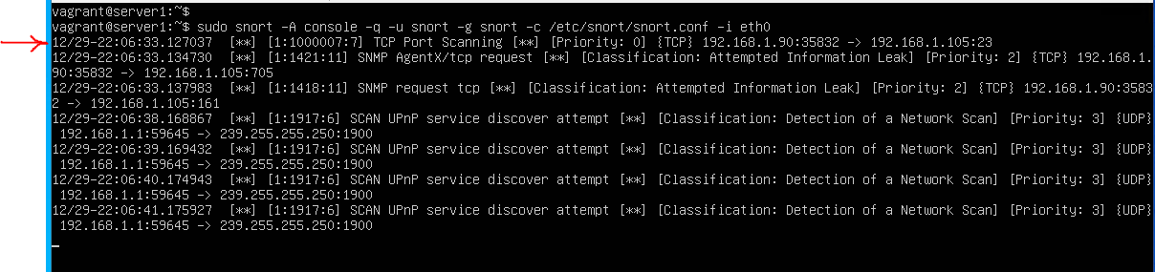
Mitigation: Blocking the Port Scan
The Snort rule is working as show from the response below.
We then start the firewall as the first layer of defense.
Then the Snort IDS as additional layer to detect future Port Scan.

Slide 56
Mitigation: Finding the Request for the Hidden Directory
What kind of alarm can be set to detect future unauthorized access?
Ans:
Set alarm for any machine accessing the /company_folders/secret_folder directory
What threshold would you set to activate this alarm?
Ans:
Http traffic > 0
What configuration can be set on the host to block unwanted access?
Ans:
Move the secret_folder away from the www/html directory to the root to prevent any access from the website
Describe the solution. If possible, provide required command lines.
Ans:
Snapshot of configurations below

Slide 57
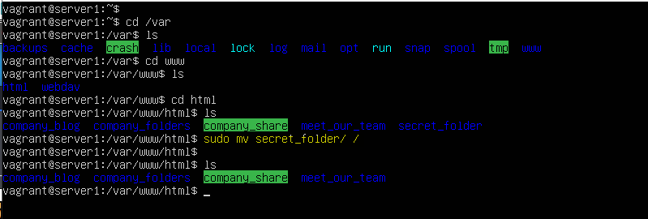
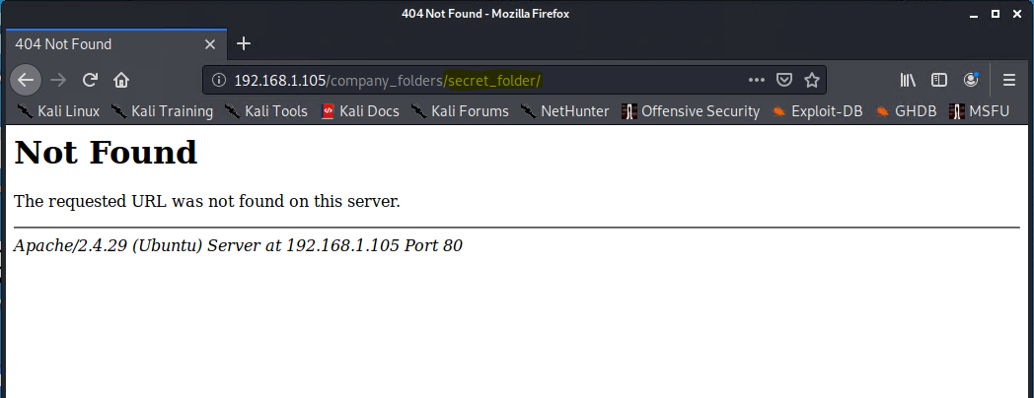

Slide 58
Mitigation: Preventing Brute Force Attacks
What kind of alarm can be set to detect future brute force attacks?
Ans:
We set alert if a response code of 401 is more than 10 from the server
What threshold would you set to activate this alarm?
Ans:
we set the threshold to :
If http status code 401 traffic is more than 10 within 30 seconds
What configuration can be set on the host to block brute force attacks?
Ans:
Change the user names from what is shown on the web pages
Change the all weak passwords to strong password.
Describe the solution. If possible, provide the required command line(s).
Ans:
Screenshot of configurations shown below.

Slide 59


We opened the common-password file using nano editor and discovered that we do not have the password quality checking library, so we need to install it as shown below

Slide 60


Slide 61

View the /etc/passwd file

Slide 62


Slide 63
Mitigation: Detecting the WebDAV Connection
What kind of alarm can be set to detect future access to this directory?
Ans:
Set alert for any http traffic to the /webdav directory
What threshold would you set to activate this alarm?
Ans:
If http traffics hits > 0
What configuration can be set on the host to control access?
Ans:
Move the /webdav directory from the www/html directory that is accessible from the web interface.
Describe the solution. If possible, provide the required command line(s).
Ans:
Screenshot shown below

Slide 64


Slide 65
Mitigation: Identifying Reverse Shell Uploads
What kind of alarm can be set to detect future file uploads?
Ans:
Set alert for any traffic from port 6666 to the server.
Set alert for any .php file upload to the server
Also set alert for any traffic from port 4444 to the server.
What threshold would you set to activate this alarm?
Ans:
If any of the above traffics hits > 0
What configuration can be set on the host to block file uploads?
Ans: Set the snort rule as thus
drop tcp any any -> 192.168.1.105 any (msg:”malicious file upload”; content:”.php”; method:”POST”; sid:1000009; rev:12;)

